Slide 1

GoZoop SEO Assignment
https://www.chesspecialrisk.ca/

Slide 2
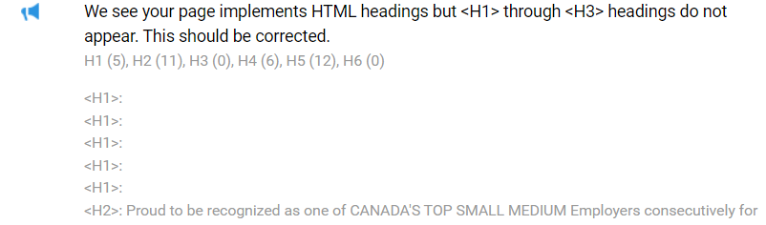


1. Pain Points
1. The weak on-page optimization seems to be one of the pain points on the website.
Multiple Blank H1 Headers on the homepage.
More than 1 interlinks pointing to a single
URL -https://www.chesspecialrisk.ca/products/
Multiple Images without Alt Tags

Slide 3
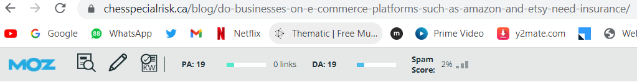
2. Blogs not promoted -
On most websites, blogs contribute to the largest amount of content.
If the blogs content is promoted properly(through link building) it can drive large traffic.
No Links build which leads to insufficient promotion.

Slide 4
2. Set of Keywords
Keywords | Competition | Keyword Difficulty | Search Volume
commercial insurance broker | Low | 32 | 720
business insurance broker | Low | 46 | 480
insurance for business liability | Low | 38 | 480
insurance on commercial property | Medium | 34 | 260
business insurance quote | Low | 46 | 90
student rental insurance | Low | 24 | 110
general liability insurance | Medium | 35 | 480
construction insurance | Low | 36 | 390
builders risk insurance | Medium | 33 | 590
travel insurance company | Low | 66 | 720
best travel insurance | Low | 70 | 1,600
home insurance quote | Low | 59 | 4,400

Slide 5
3. Strategy for Ranking Keywords
Page Speed Optimization & Technial -
Checking and resolving the technical shortcomings on the website to overcome them.
Ref: https://pagespeed.web.dev/report?url=https%3A%2F%2Fwww.chesspecialrisk.ca%2F&form_factor=mobile
On Page Optimization -
Title & Meta Description optimization
Image Optimization
Optimizing Page Headers
Checking and optimizing blog content.
Off-page Optimization –
Social Bookmarking for Blogs
Converting Blogs to Podcasts and sharing
Creating listings for various locations
Creating infographics from blogs and submitting
Writing Q&As
Doing Forum Submissions with useful content

Slide 6
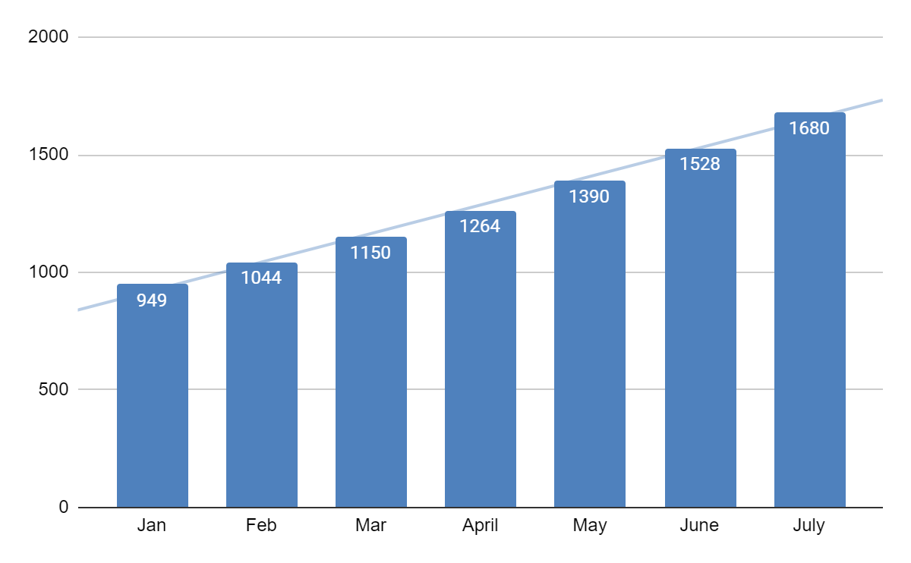
4. Traffic Estimations for the next 6 month
Based on the current traffic and the search volume of the keywords we plan to target 10% MOM growth in current traffic.

Slide 7
5. Demo Account
We have observed that the website received 329,094 Users in the month of December ‘22 when compared to November ‘22 which has 356,239 Users has declined by 7.62% and also New Users for the website have also decreased from 284,021 to 273,565 by 6.96%
Audience Overview | Nov-22 | Dec-22 | Total Change(%)
Users | 314,977 | 304,581 | 2.67
New Users | 284,021 | 273,621 | 0.33
Sessions | 401,281 | 385,198 | -1.37
Number of Sessions per User | 127.00% | 1.26 | -4.55
Pageviews | 680,812 | 646,176 | -12.75
Avg. Session Duration | 0:01:55 | 0:01:52 | -18.84
Bounce Rate | 69.80% | 70.65% | 11.07

Slide 8
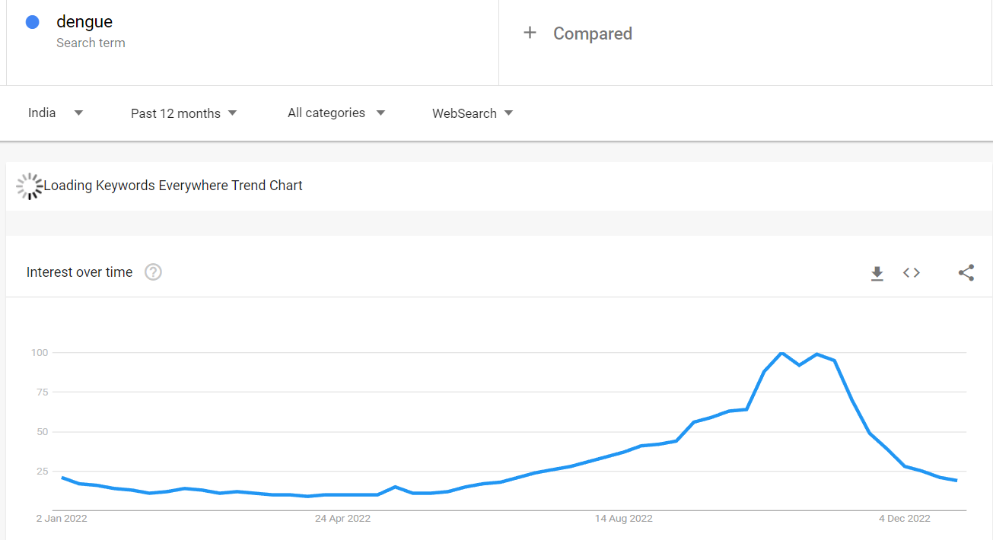
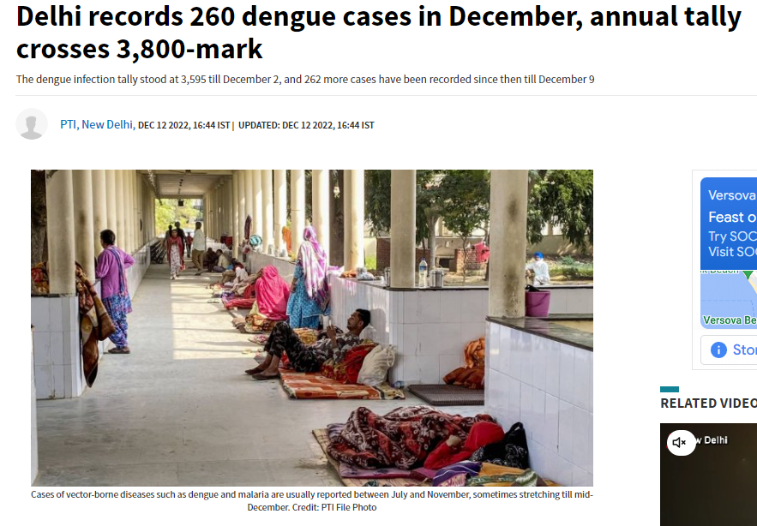
Dengue Analysis
We have analysed 72% traffic decline in traffic from Dengue visitors. It contributes to 38.65% of the total traffic loss. Dengue cases have gone down drastically in Dec 2022.
# | New Users | Clicks | Impressions
Nov | 14295 | 15457 | 620848
Dec | 3974 | 4287 | 188976
Difference | -10321 | -11170 | -431872
Change (%) | -72.20 | -72.26 | -69.56
Total Change (%) | 38.65 | 29.68 | 42.89
The number of dengue cases in Delhi was 1,238 in Oct’22 while in Nov’22 it was 1,420 cases. This fell to jst 260 cases in Dec’22.
Ref: https://www.deccanherald.com/national/north-and-central/delhi-records-260-dengue-cases-in-december-annual-tally-crosses-3800-mark-1170995.html

Slide 9
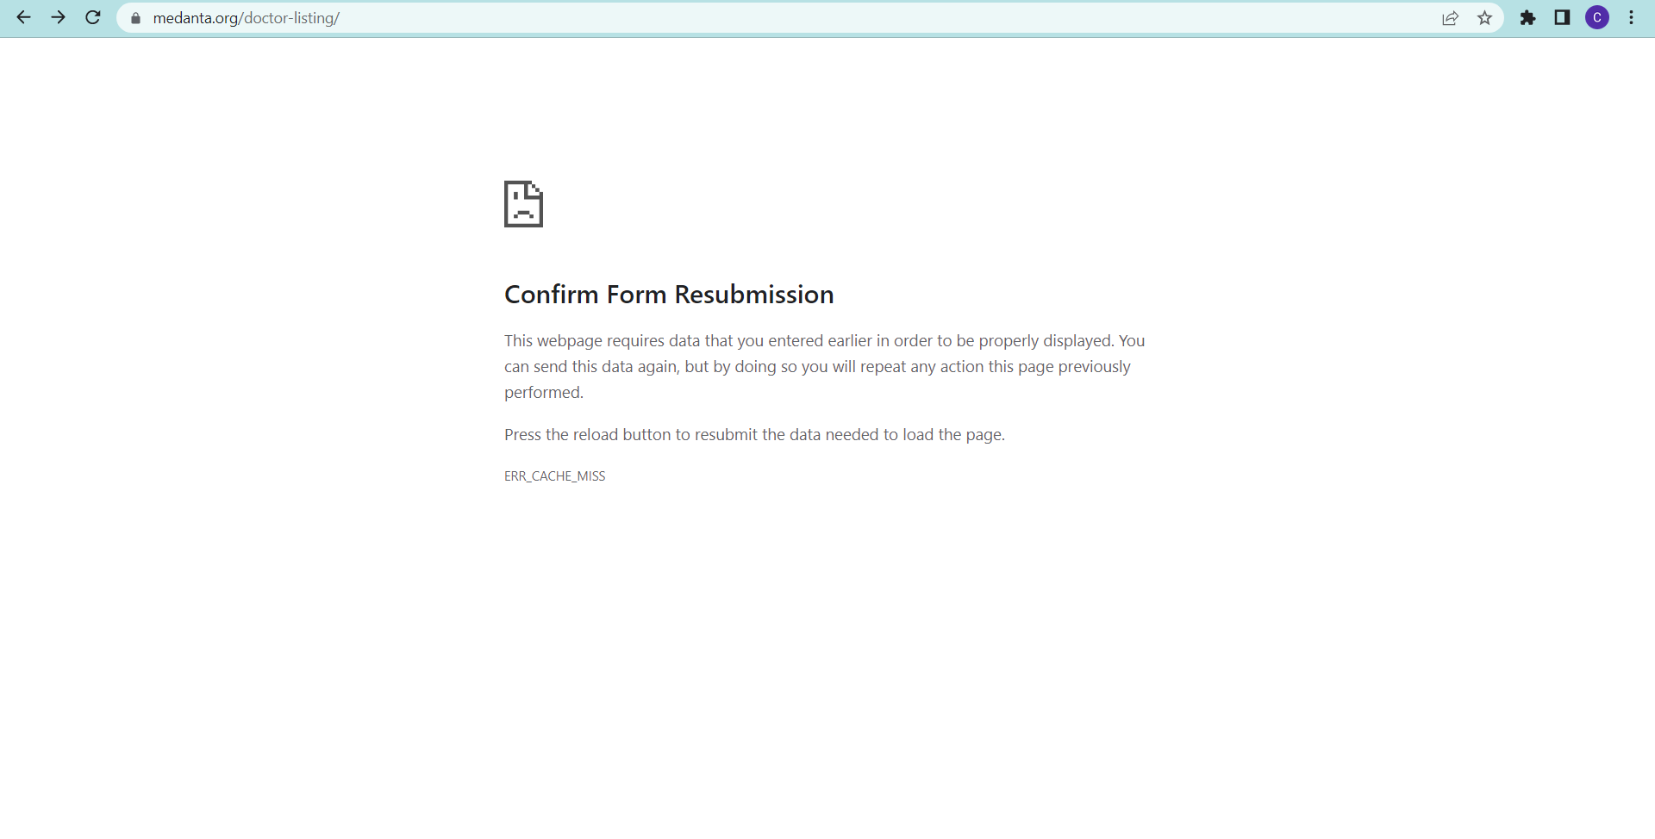
Doctor Listings Analysis
We have analysed 4.62% traffic drop from Doctor’s Listing Page. It contributes to 4.48% of the total traffic loss. This page is showing 203 error which affects the website UI/UX and traffic.
# | New Users | Clicks | Impressions
Nov | 25898 | 36248 | 1093986
Dec | 24702 | 29984 | 1020793
Difference | -1196 | -6264 | -73193
Change (%) | -4.62 | -17.28 | -6.69
Total Change (%) | 4.48 | 16.65 | 7.27

Slide 10
Suggested Actionables
We highly recommend writing blogs on new trending topics with relevant seasonal diseases to recover the traffic lost from Dengue blogs.
To improve the traffic coming from brand pages we can run branding campaigns on social media or paid media.
The doctor listing pages gain much traffic from doctor names keywords. Recommend resolving the errors at the earliest.
Highly recommend checking for all the 400 & 500 errors on website and removing the errors so for smoother operation of the website

Slide 11
Let’s Discuss…

